Slide 1

Ch.16. Implementing Authentication
with PHP and MySQL
Siva R Jasthi
ICS325 – Internet Application Development
Information and Computer Sciences
Metropolitan State University

Slide 2
Outline
Authentication vs Authorization
Securing pages, directories, entire application.
HTTP Basic Authentication through PHP
Cookie and Session Control through PHP.
Encrypting user names and passwords in MySQL database

Slide 3
Authentication vs Authorization
These sound similar, but are very distinct
Authentication: Most applications need to know the identity of a user. Knowing a user’s identity allows an app to provide a customized experience and grant them permissions to access their data. The process of proving a user’s identity is called authentication.
Authorization: The process of authorization is distinct from that of authentication. Whereas authentication is the process of verifying that "you are who you say you are", authorization is the process of verifying that "you are permitted to do what you are trying to do". Authorization thus presupposes authentication.

Slide 4
Authentication Mechanisms
HTTP Basic Authentication through PHP Scripts:
Requesting a Web Browser for some help in authenticating the users
Session Control
Relying on PHP and MySQL to authenticate users and using the sessions to control their interactions

Slide 5
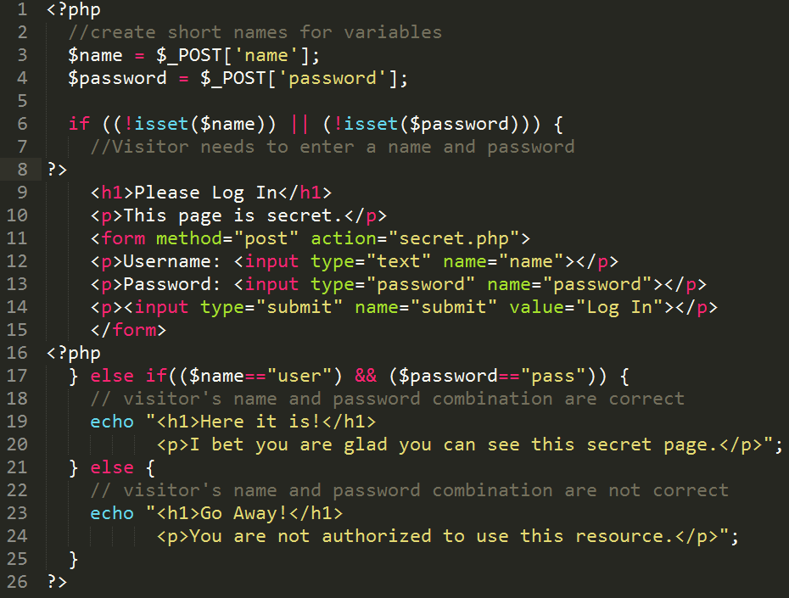
Let us review
chapter17/secret.php

Slide 6
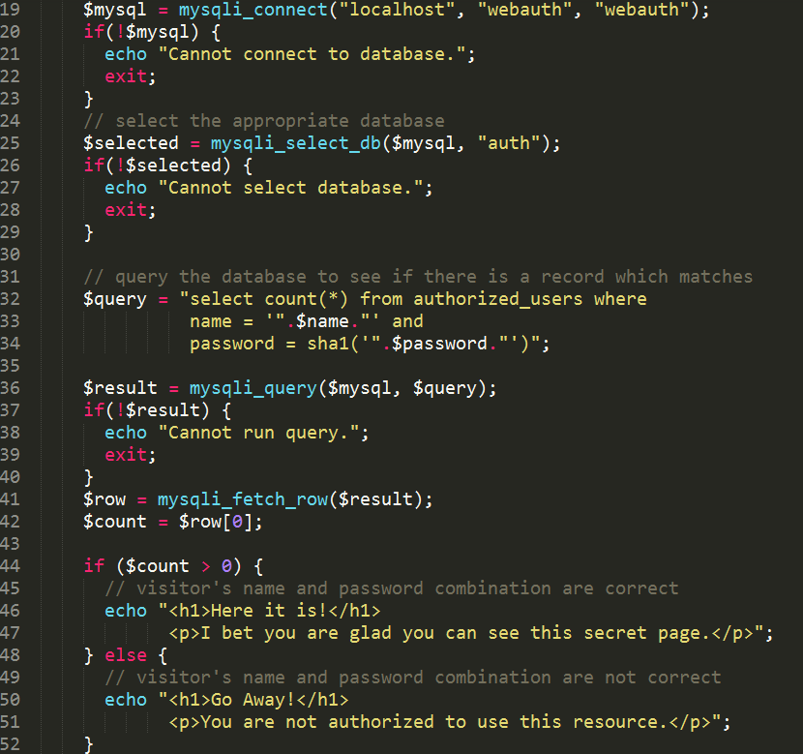
Let us review
chapter17/scretdb.php
It is a bad idea to store the user names and passwords in PHP files or in flat files,
secretdb.php listing provides the code snippet using the database to authenticate an user

Slide 7
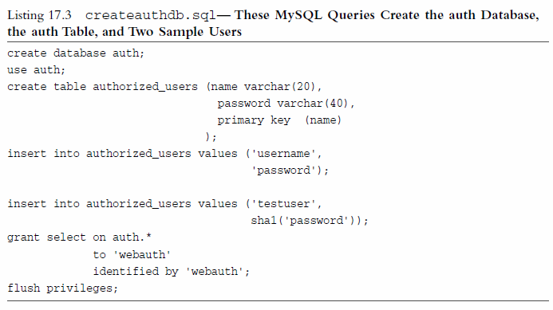
A sample script to create a couple of users in the database

Slide 8
Encrypting the passwords
Instead of storing the passwords in plain-text format in the database, it makes sense to encrypt the passwords using one-way hashing algorithms.
Both PHP and MySQL provides several algorithms to do such hashing.
SHA -1 (Secure Hashing Algorithm) is one such encryption method that is used both by PHP and MySQL.
You only need to do only once – either in MySQL or in PHP

Slide 9
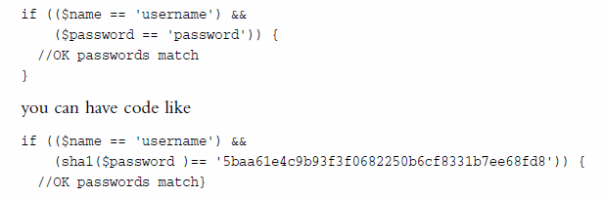

Encrypting the passwords (Contd.)
PHP Way
MySQL way

Slide 10
Summary of Authentication Mechanisms
HTTP Basic Authentication through PHP Scripts:
Requesting a Web Browser for some help in authenticating the users
Session Control (over to chapter 23)
Relying on PHP and MySQL to authenticate users and using the sessions to control their interactions

